Slide 1
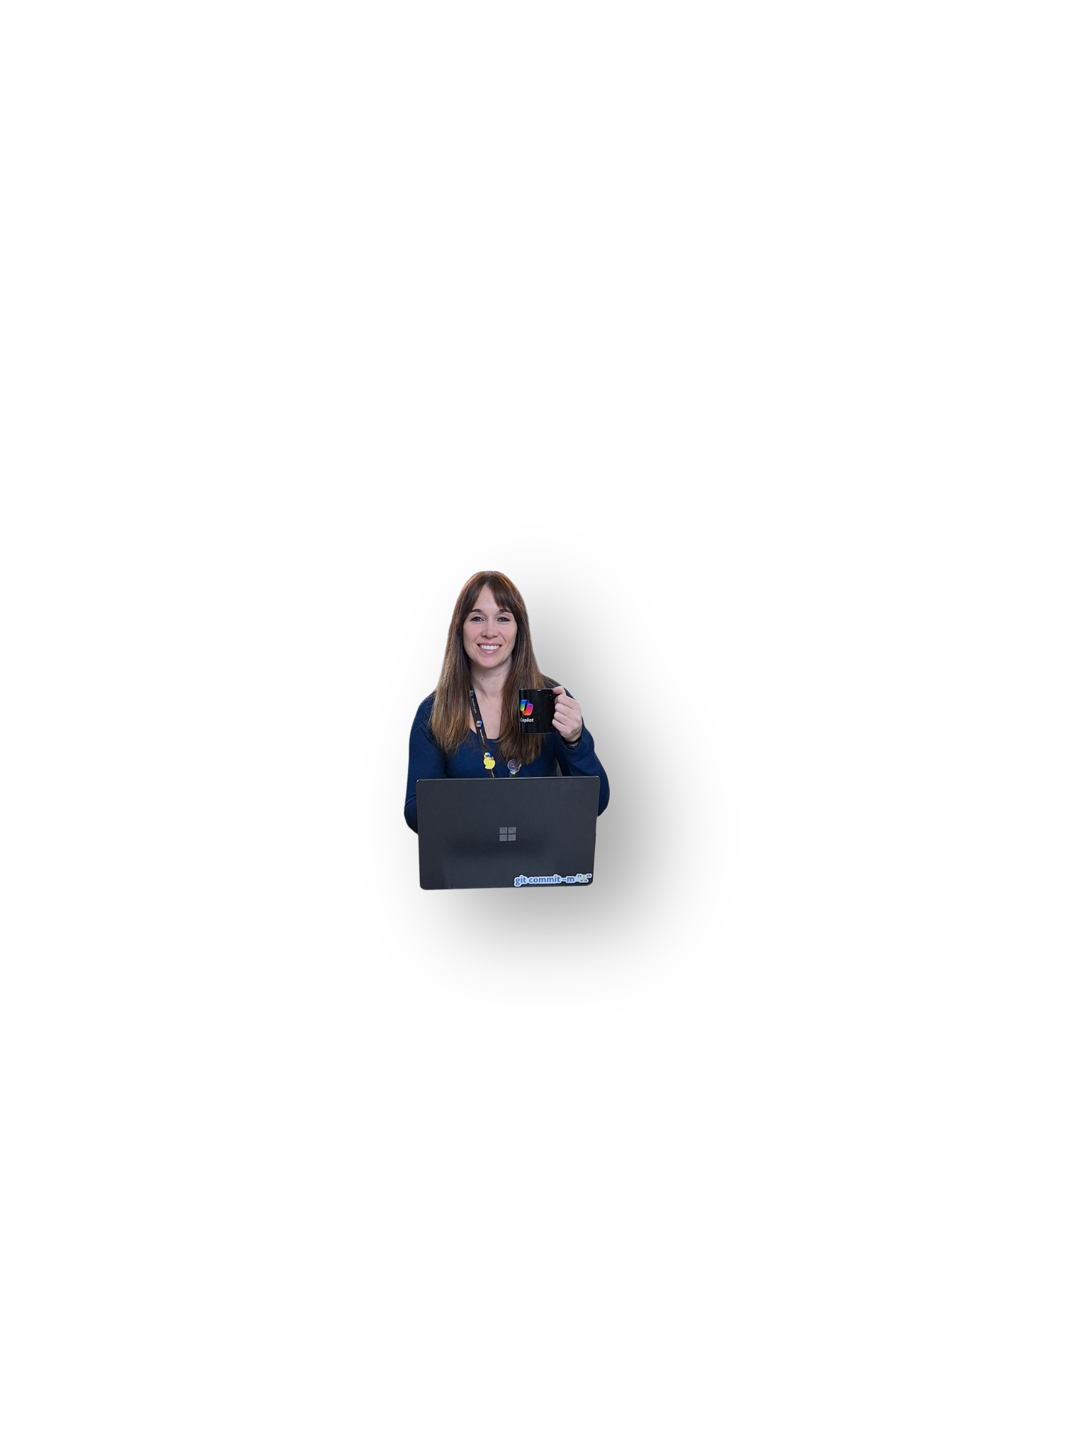








CHARLA
Desarrolladores/DBA/Data scientists más felices y productivos con Platform Engineering
Viernes 21, Nov
11:00am - 11:50am
GISELA TORRES
TRACK PRINCIPAL - AULA MAGNA
X-OPS CONFERENCE 2025

Slide 2

CHARLA
Migración inteligente: Containeriza tu aplicación heredada con MCP
Viernes 21, Nov
04:00pm - 04:50pm
ROSSANA SUAREZ
TRACK HYPERSCALERS - SALA NEXT DIGITAL
X-OPS CONFERENCE 2025

Slide 3
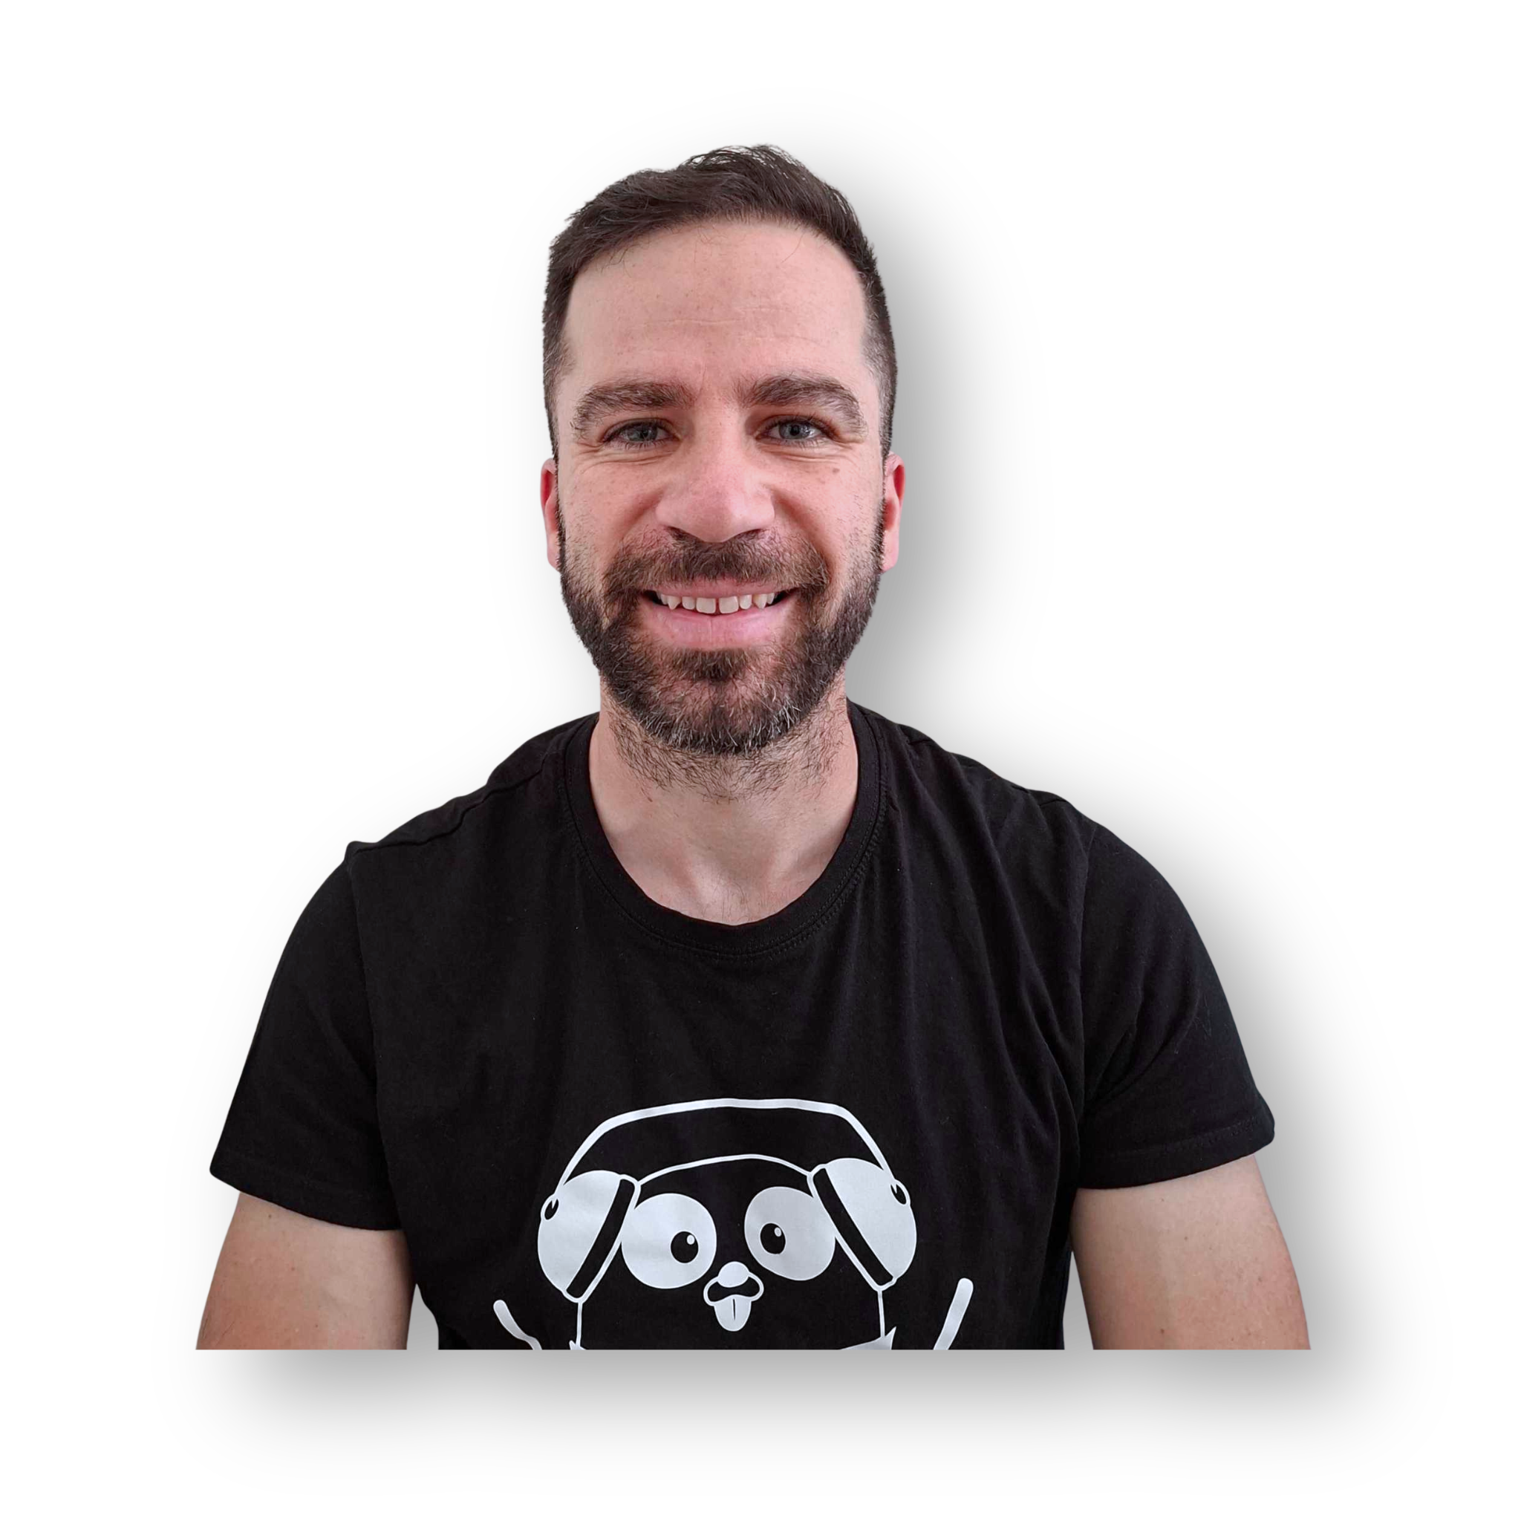
CHARLA
$Git It Done: API Management as Code (The DevOps & Platform Team Dream)
Viernes 21, Nov
01:40pm - 02:30pm
CARLOS VILLANÚA
TRACK PRINCIPAL - AULA MAGNA
X-OPS CONFERENCE 2025

Slide 4

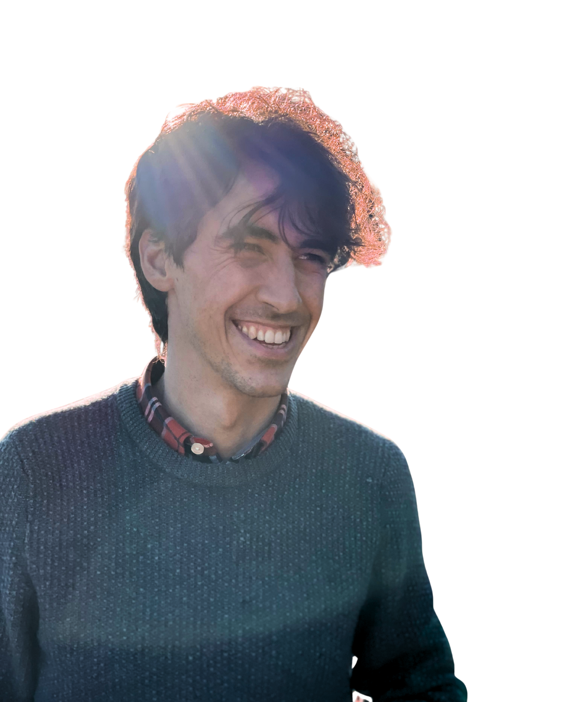
CHARLA
Implementando un sistema de Machine Learning observable en la nube
Viernes 21, Nov
04:00pm - 04:50pm
SARA SAN LUÍS
CHRISTIAN CARBALLO
TRACK PRINCIPAL - AULA MAGNA
X-OPS CONFERENCE 2025

Slide 5

CHARLA
Web UI: What’s New and What’s Next
Viernes 21, Nov
02:30pm - 03:00pm
CLEYRA UZCATEGUI
TRACK PRINCIPAL - AULA MAGNA
X-OPS CONFERENCE 2025

Slide 6
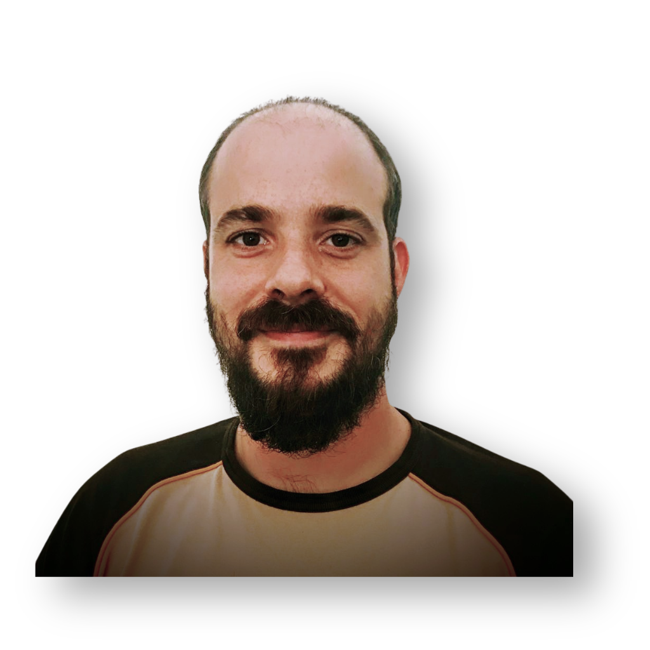
CHARLA
Automated Baremetal deployment with CAPI + ClusterClass
Viernes 21, Nov
11:50am - 12:20pm
ALBERTO MORGANTE
TRACK PRINCIPAL - AU.LA MAGNA
X-OPS CONFERENCE 2025

Slide 7
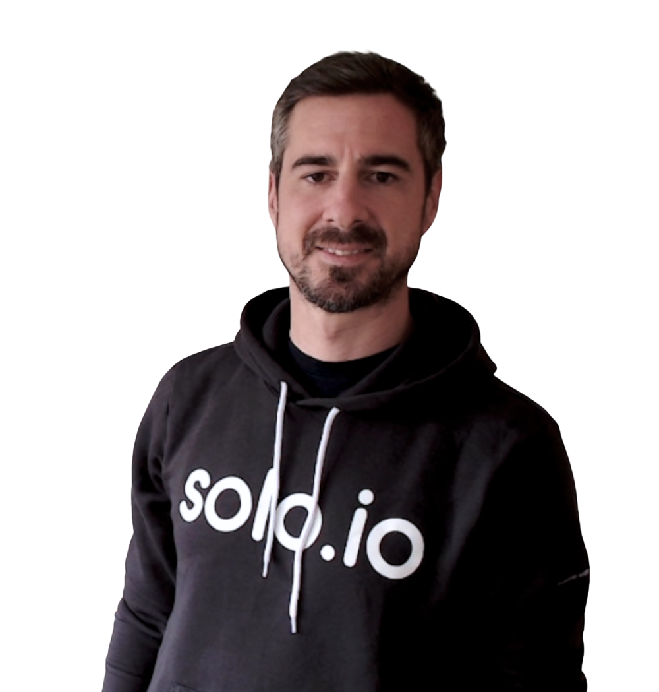
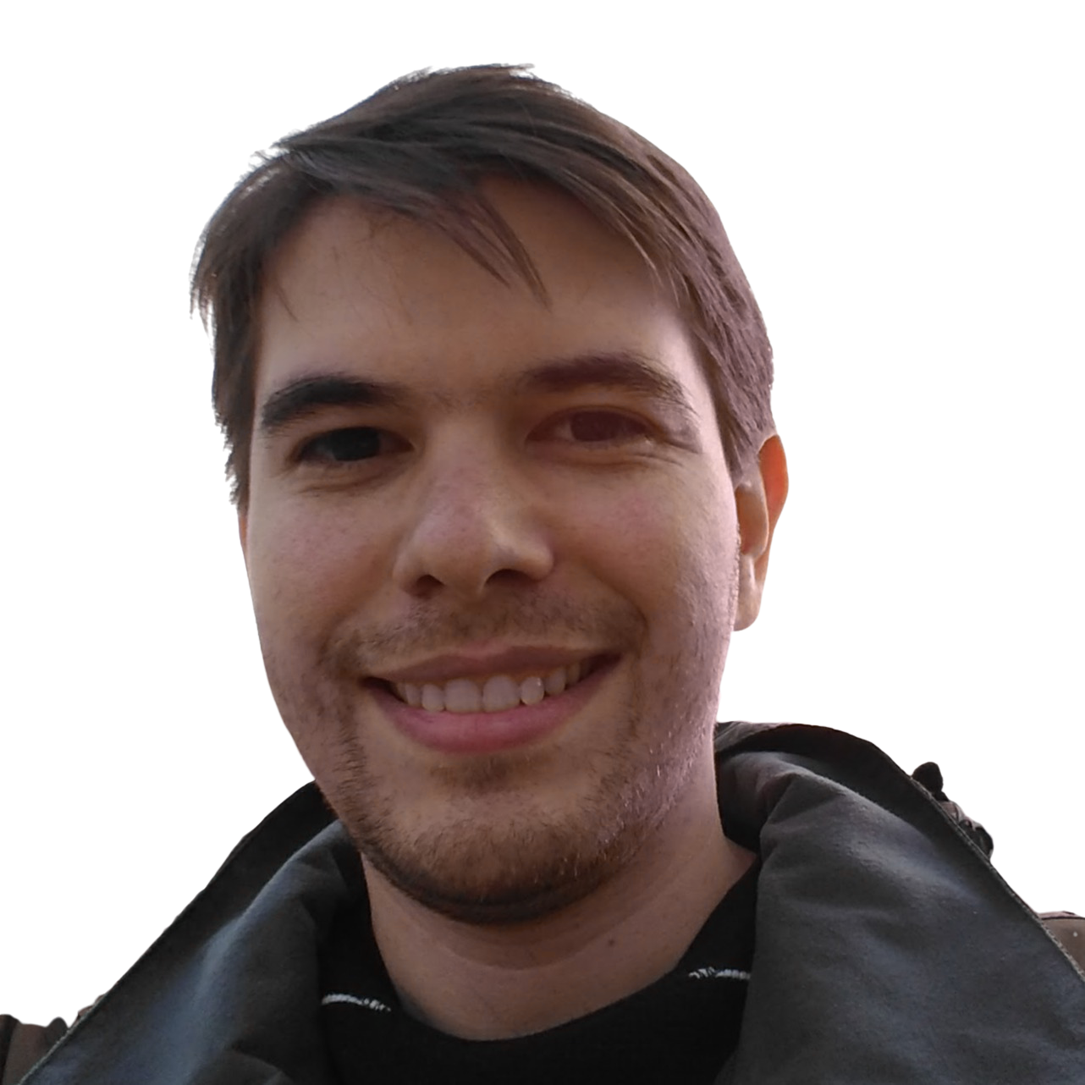
CHARLA
De Becario en formación a Agente Épico. Evolución de la IA en Infraestructuras Críticas Seguras.
Viernes 21, Nov
12:50pm - 01:40pm
ANTONIO BERBEN
FELIPE VICENS
TRACK PRINCIPAL - AULA MAGNA
X-OPS CONFERENCE 2025

Slide 8
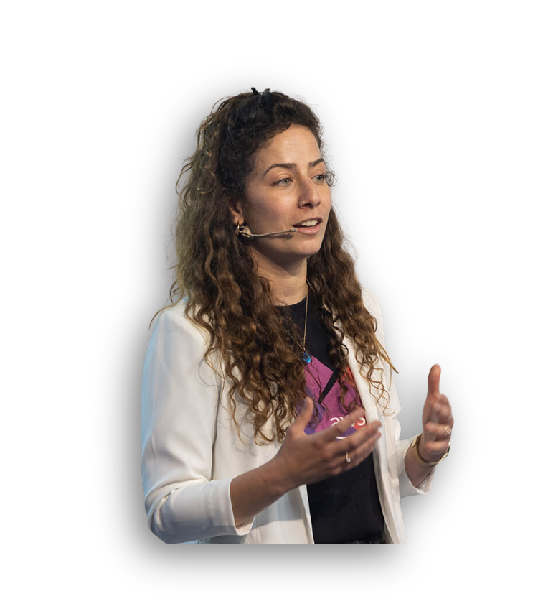
CHARLA
Kubernetes as a Platform: From infrastructure as code to API-driven infrastructure
Viernes 21, Nov
11:00am - 11:45am
SHANI KAZAZ
TRACK HYPERSCALERS - SALA NEXT DIGITAL
X-OPS CONFERENCE 2025

Slide 9
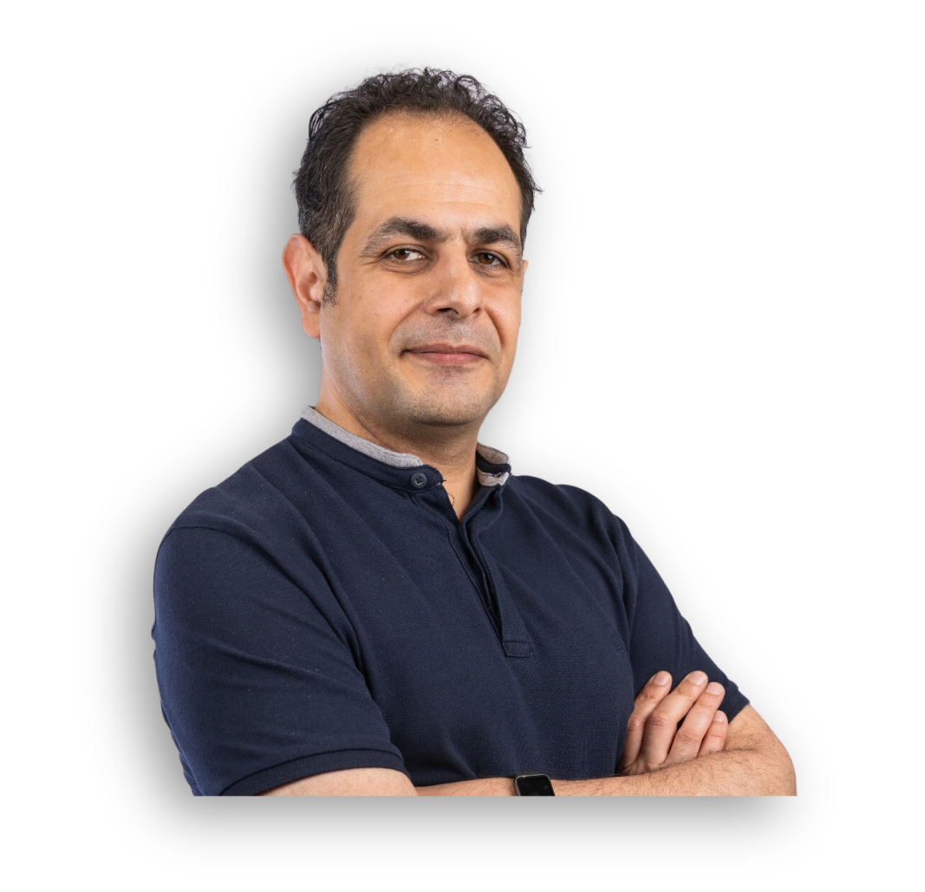
TALLER
Modernizing EKS workloads: Performance & Cost at Scale with Graviton and Karpenter
Viernes 21, Nov
13:55pm - 03:25pm
MANI GHELICHKHANI
TRACK HYPERSCALERS - SALA NEXT DIGITAL
X-OPS CONFERENCE 2025

Slide 10
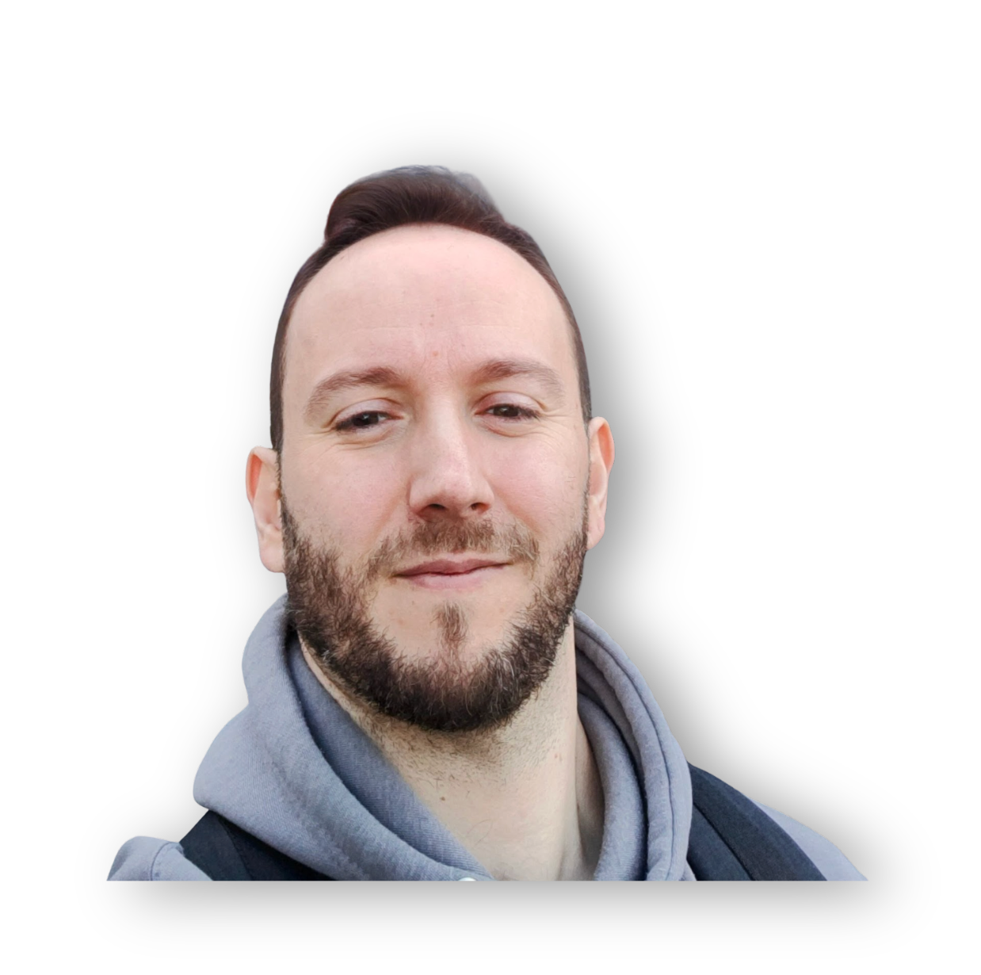
CHARLA
Scale Your Monitoring Solution With the VictoriaMetrics Ecosystem
Sábado 22, Nov
01:35pm - 02:20pm
JOSE GÓMEZ-SELLÉS
TRACK HYPERSCALERS - SALA NEXT DIGITAL
X-OPS CONFERENCE 2025

Slide 11
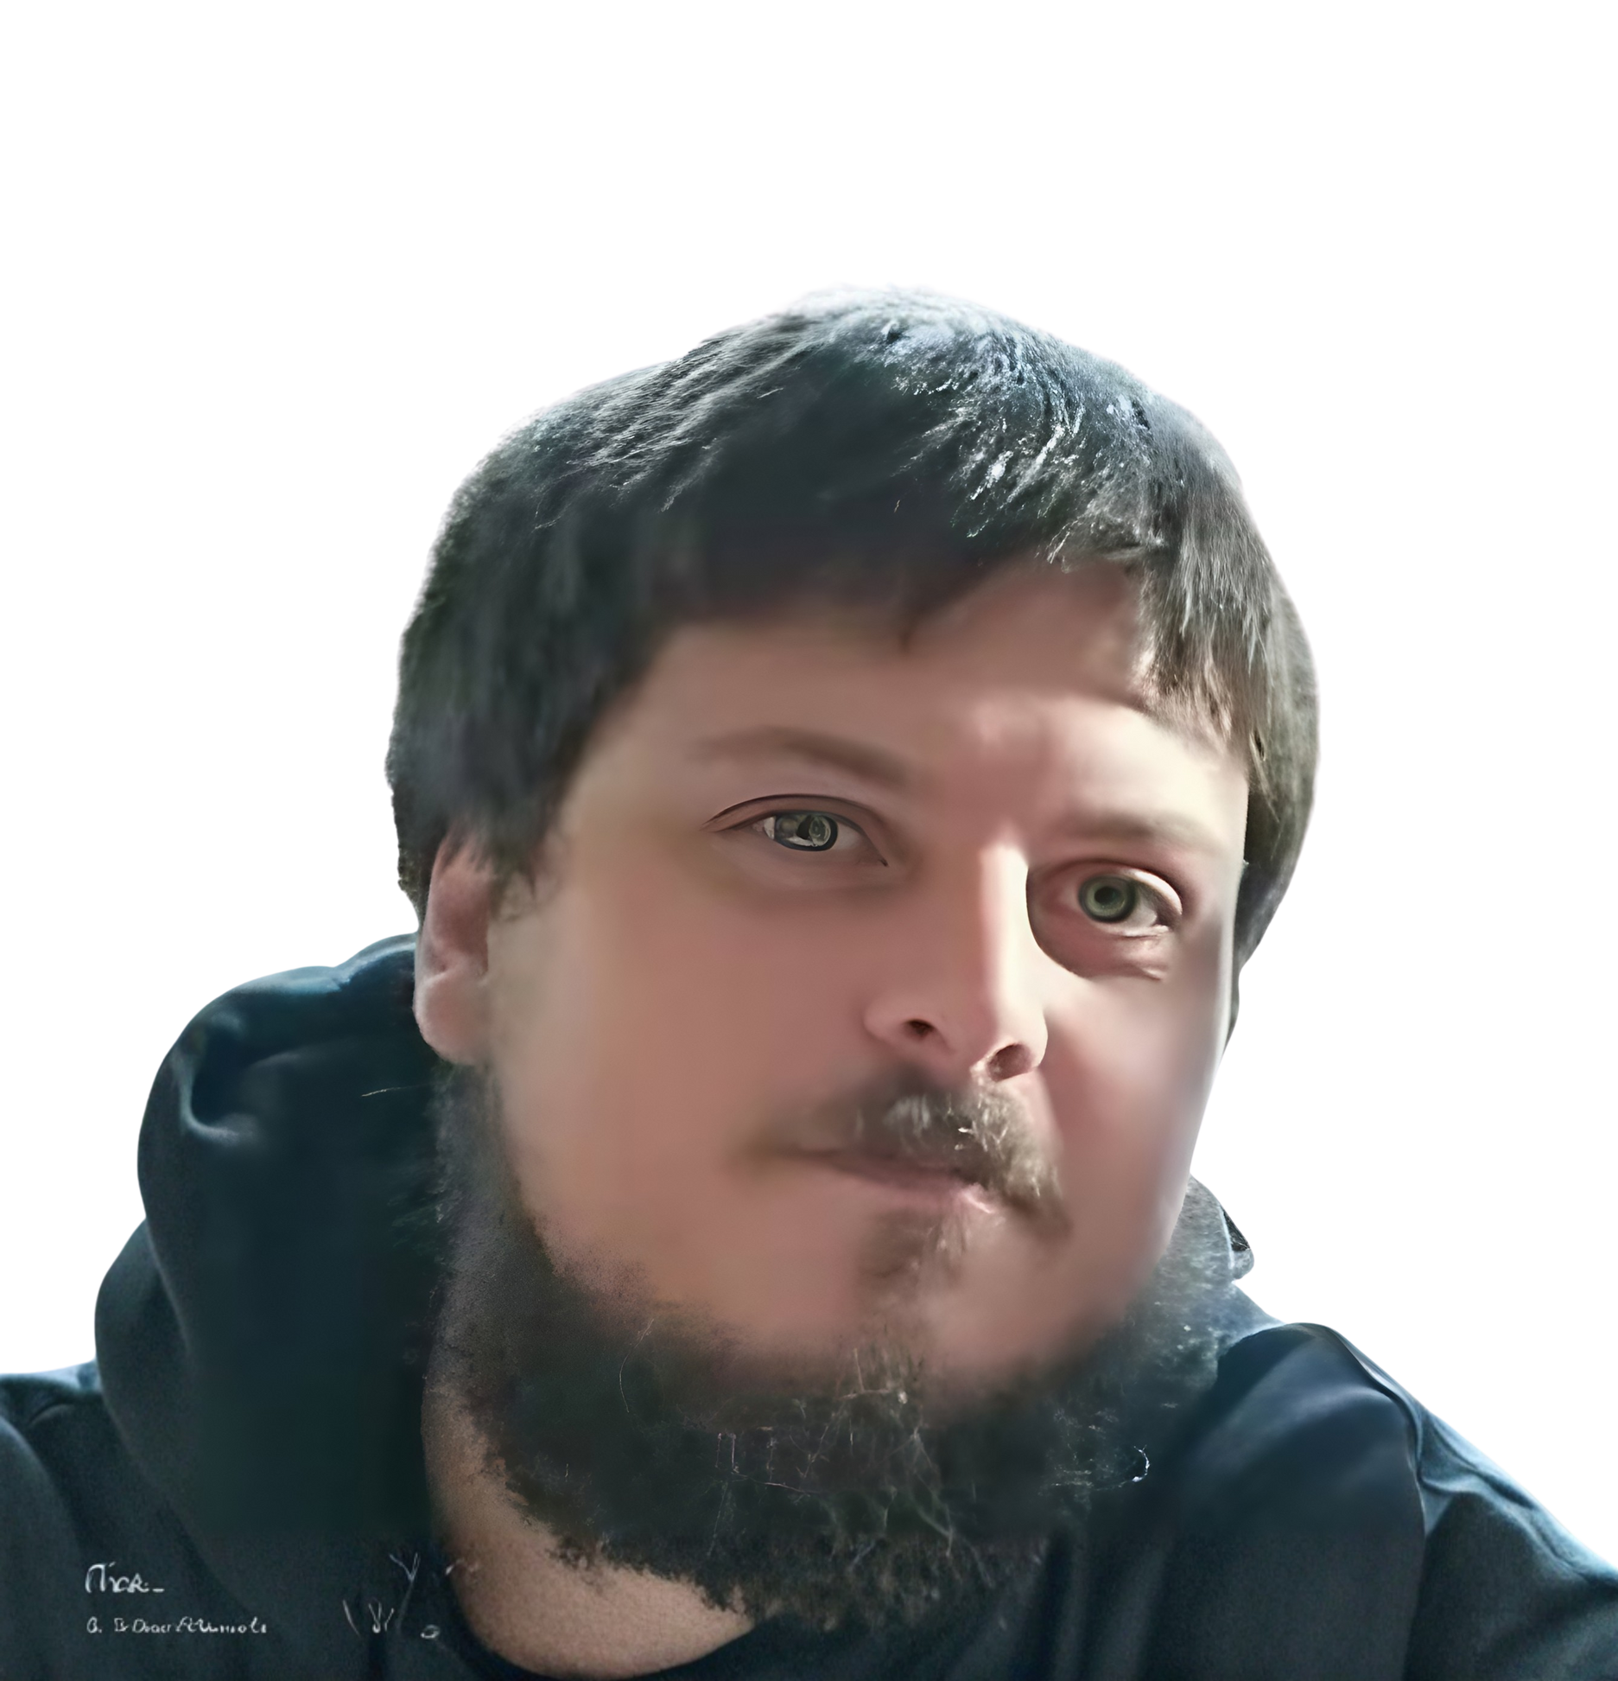
CHARLA
De 0 a 100 con Ansible en AWX
Viernes 21, Nov
11:45am - 12:30pm
ALEJANDRO DE LA HOZ MARTIN
TRACK HYPERSCALERS - SALA NEXTDIGITAL
X-OPS CONFERENCE 2025

Slide 12
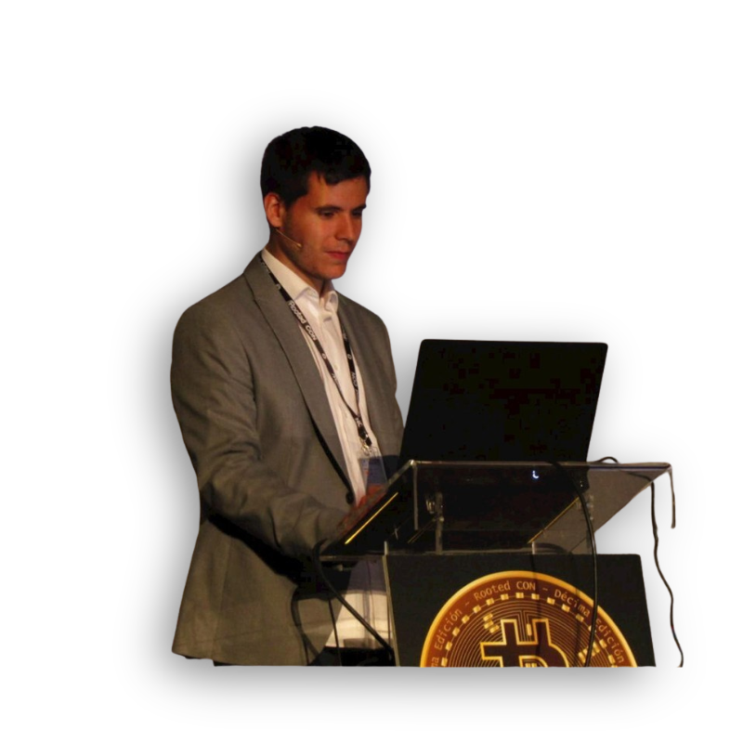
TALLER
Offensive Hardware Hacking I+D+I VS Conceptos y filosofía devops/devsecops
Sabado 22, Nov
04:00pm - 06:00pm
DAVID REGUERA GARCIA
TRACK BSIDES MADRID - SALA NEXT DIGITAL
X-OPS CONFERENCE 2025

Slide 13
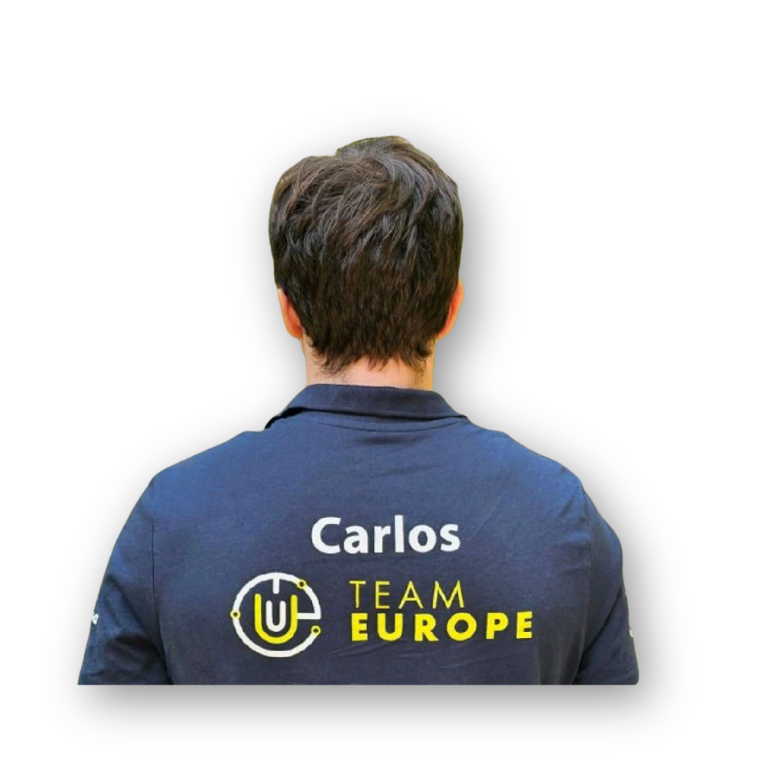
CHARLA
GCP Vulnerabilities & Features of Offensive Engineers
Sabado 22, Nov
10:30am - 11:30am
CARLOS POLOP
TRACK BSIDES MADRID - SALA NEXT DIGITAL
X-OPS CONFERENCE 2025

Slide 14
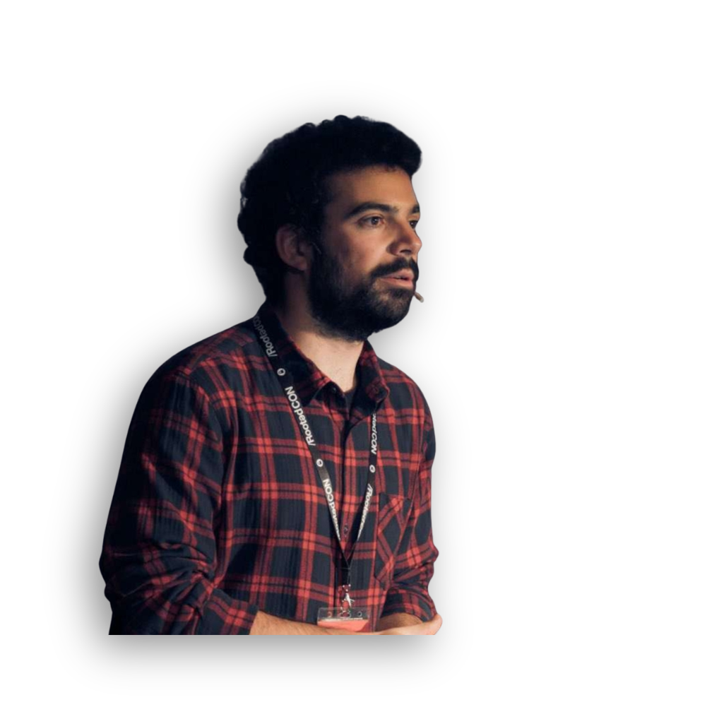
TALLER
Hacking CI/CD Pipelines
Sabado 22, Nov
12:50pm - 02:10pm
IGNACIO DOMINGUEZ
TRACK BSIDES MADRID - SALA NEXT DIGITAL
X-OPS CONFERENCE 2025

Slide 15
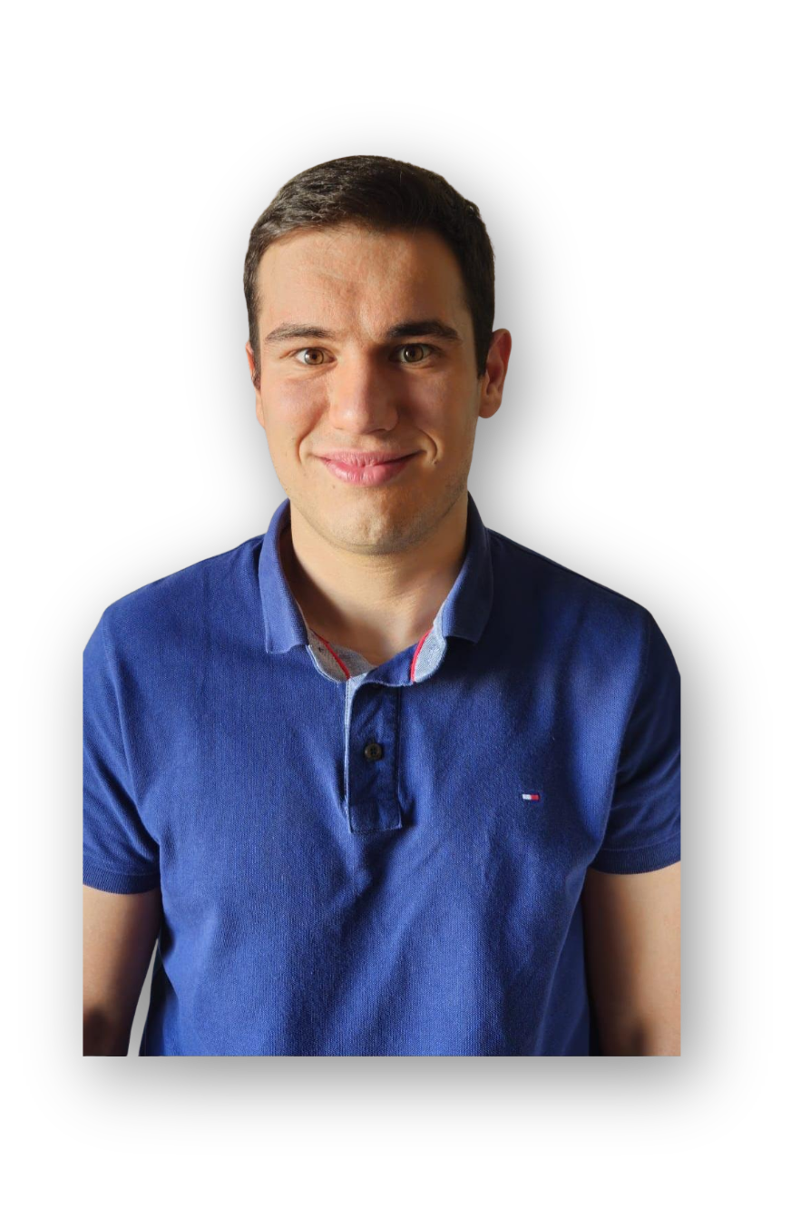
CHARLA
Ciberseguridad y OT. ¿Friends or enemies?
Sabado 22, Nov
02:10pm - 03:00pm
ALBERTO LOBATO
TRACK BSIDES MADRID - SALA NEXT DIGITAL
X-OPS CONFERENCE 2025

Slide 16
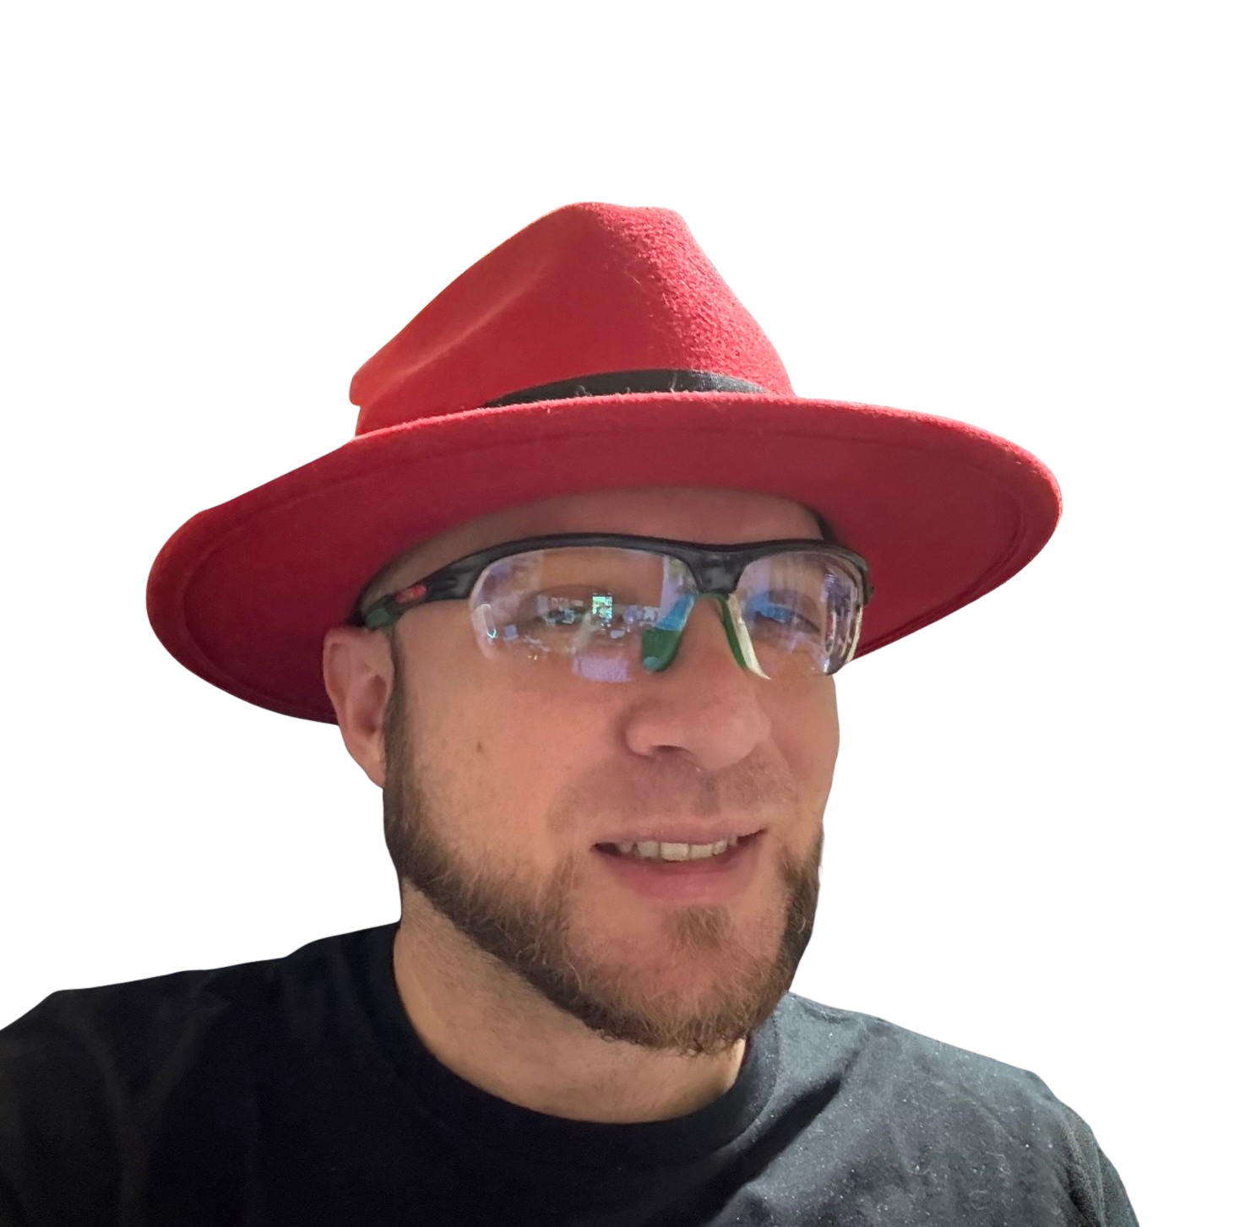
CHARLA
Secure by Design: Integrando Threat Modeling en el Ciclo de Vida MLOps con OpenShift AI
Sabado 22, Nov
11:30am - 12:20pm
JUAN VICENTE HERRERA
TRACK BSIDES MADRID - SALA NEXT DIGITAL
X-OPS CONFERENCE 2025

Slide 17
CHARLA
Keynote principal
Viernes 21, Nov
09:30am - 10:00am
JUAN VICENTE HERRERA
TRACK PRINCIPAL - AULA MAGNA
X-OPS CONFERENCE 2025

Slide 18
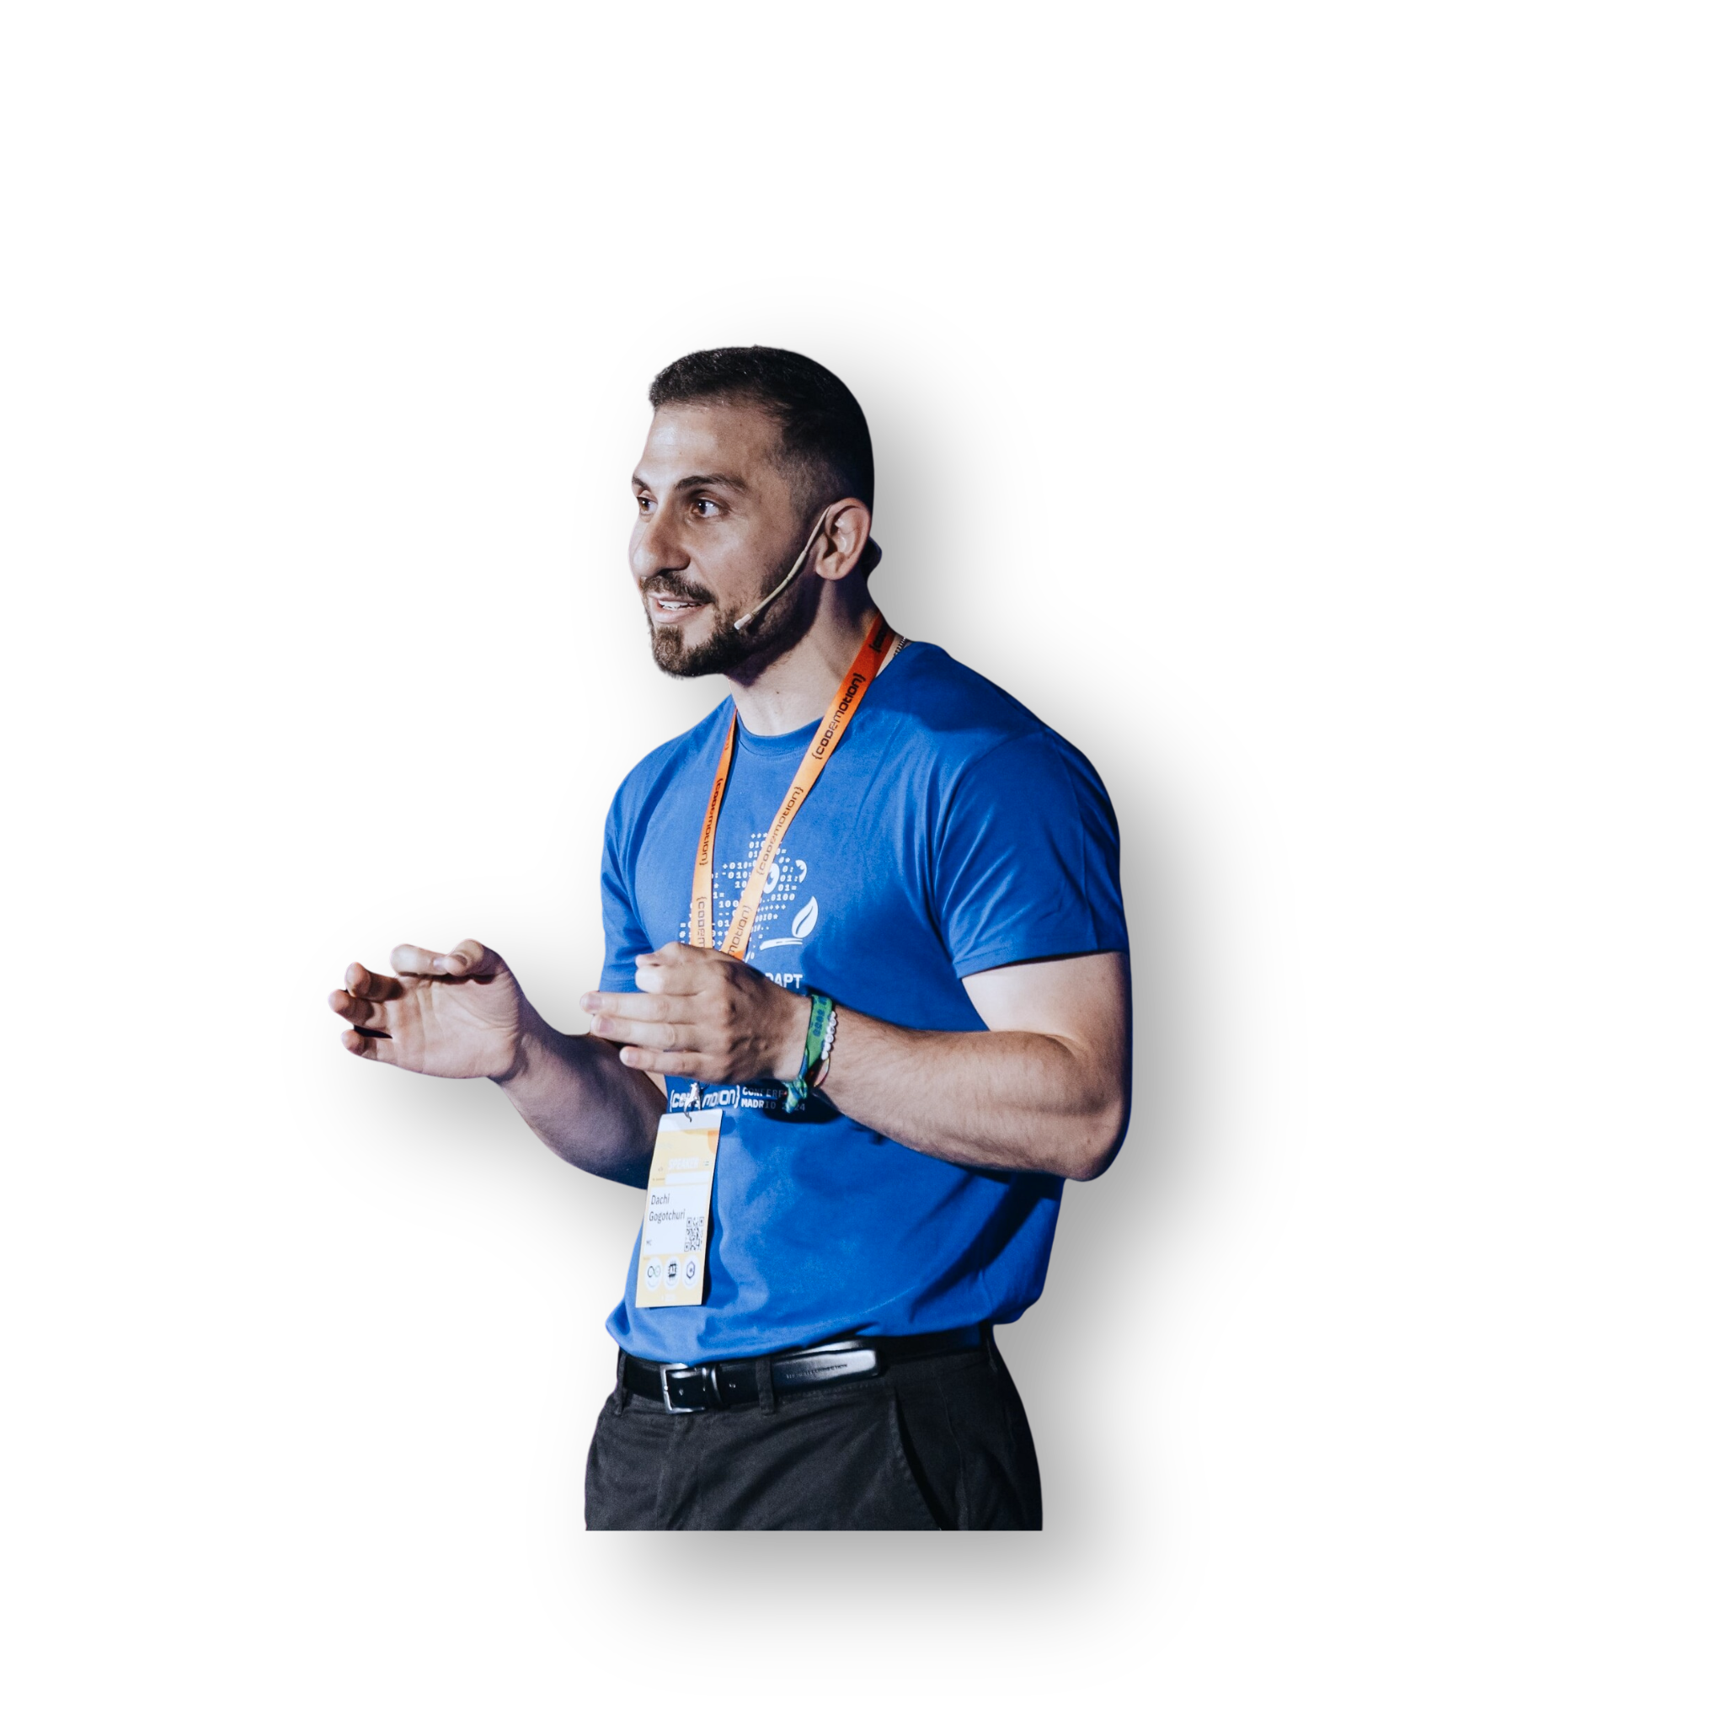
CHARLA
IA generativa en DevSecOps: automatización inteligente de pipelines
Sábado 22, Nov
10:30am - 11:00am
DACHI GOGOTCHURI
TRACK PRINCIPAL - AULA MAGNA
X-OPS CONFERENCE 2025

Slide 19
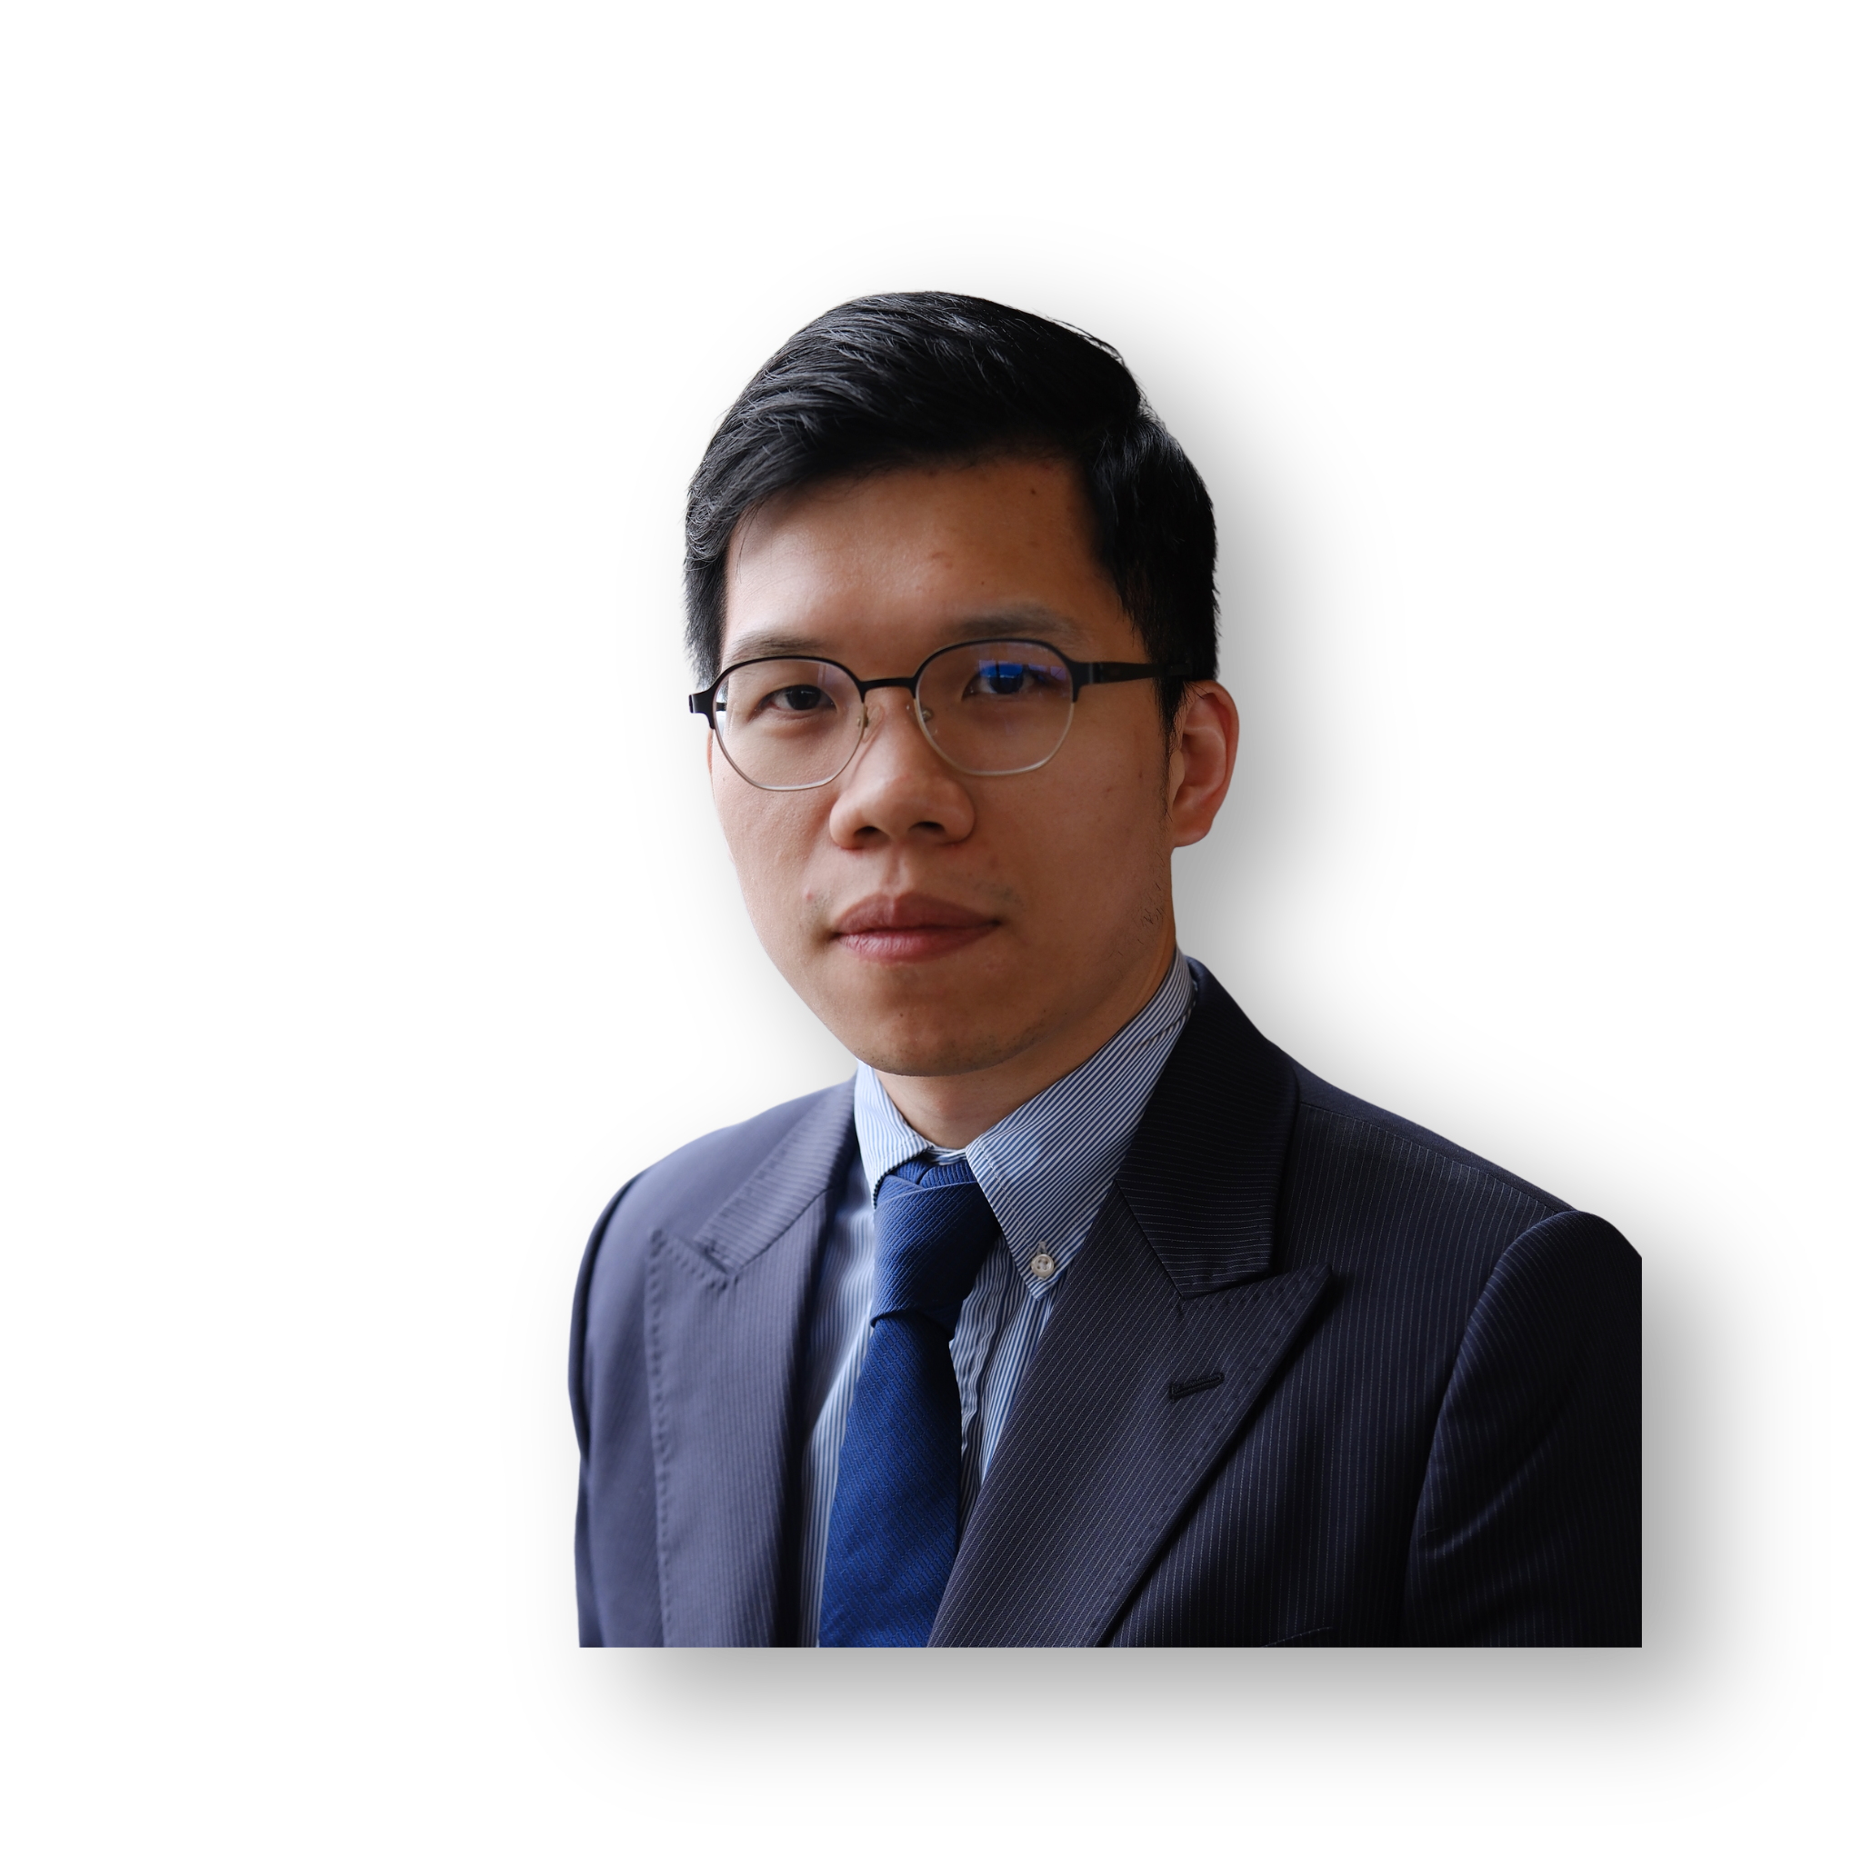
CHARLA
Make Rival GPUs Play Nice—Slash Latency 45 % Without Buying More Cards
Sábado 22, Nov
12:50pm - 01:35pm
X-OPS CONFERENCE 2025
JEFF FAN
TRACK PRINCIPAL - AULA MAGNA

Slide 20
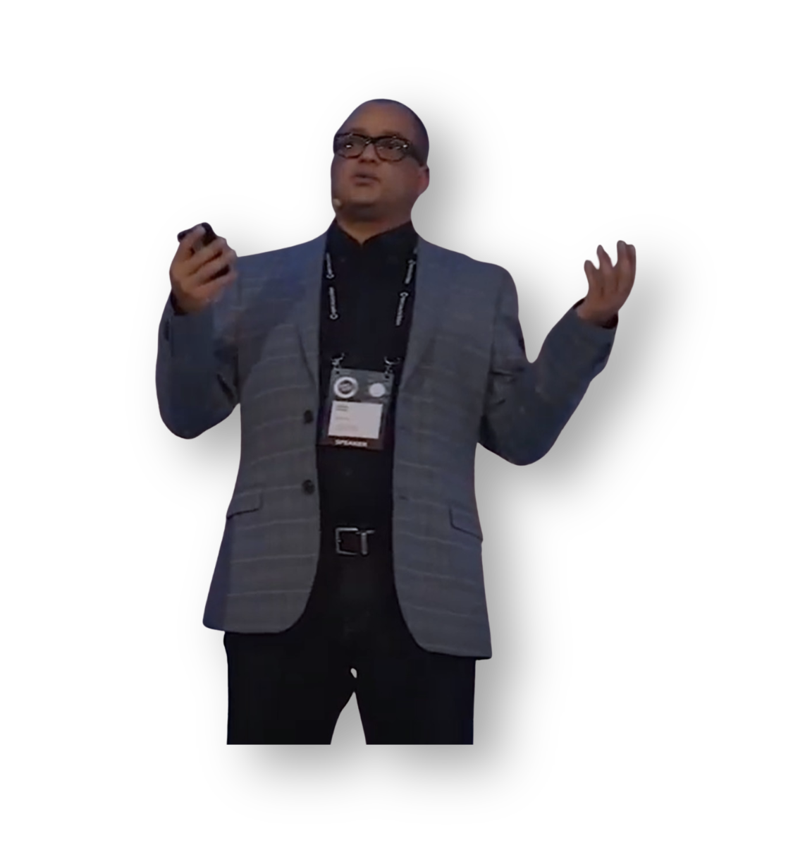
CHARLA
Automating Database CI/CD with Oracle DB Operator, GitHub Actions, and Liquibase
Sábado 22, Nov
02:20pm - 03:00pm
JUAREZ JUNIOR
TRACK PRINCIPAL - AULA MAGNA
X-OPS CONFERENCE 2025

Slide 21
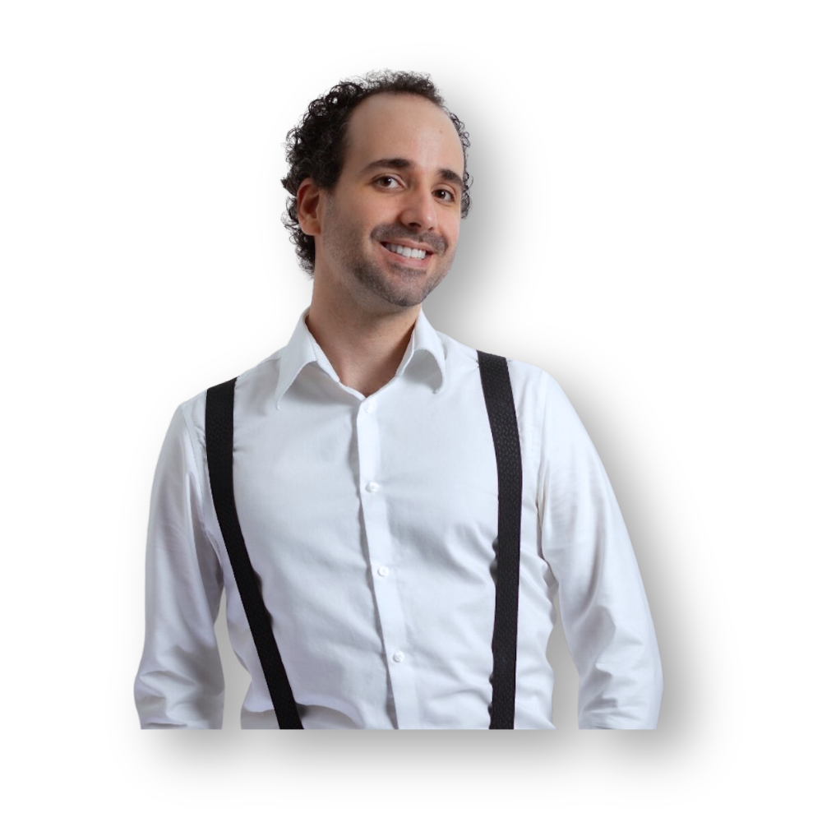
CHARLA
Evolutionary Architecture: the art of making decisions
Sábado 22, Nov
04:00pm - 04:50pm
JOSÉ ENRIQUE CALDERÓN SANZ
TRACK PRINCIPAL - AULA MAGNA
X-OPS CONFERENCE 2025

Slide 22
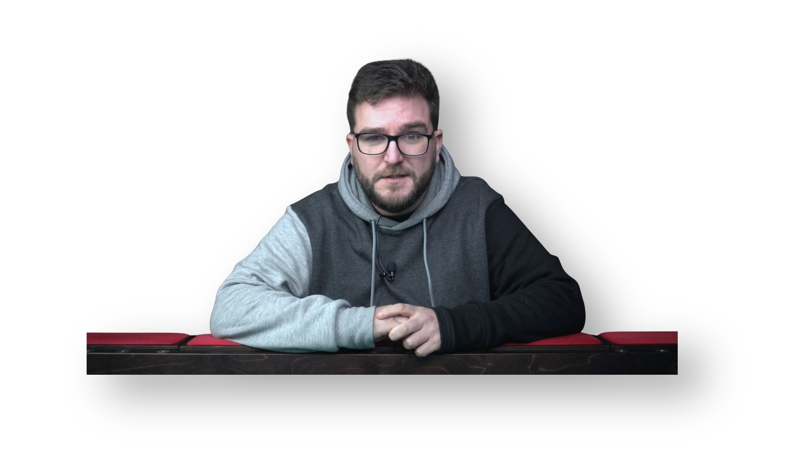
CHARLA
Estrategias de Visualización de Datos para Comunicadores: Contando Historias con Números
Sábado 22, Nov
04:50pm - 05:40pm
DAVID AMORÍN GARCÍA
TRACK PRINCIPAL - AULA MAGNA
X-OPS CONFERENCE 2025

Slide 23
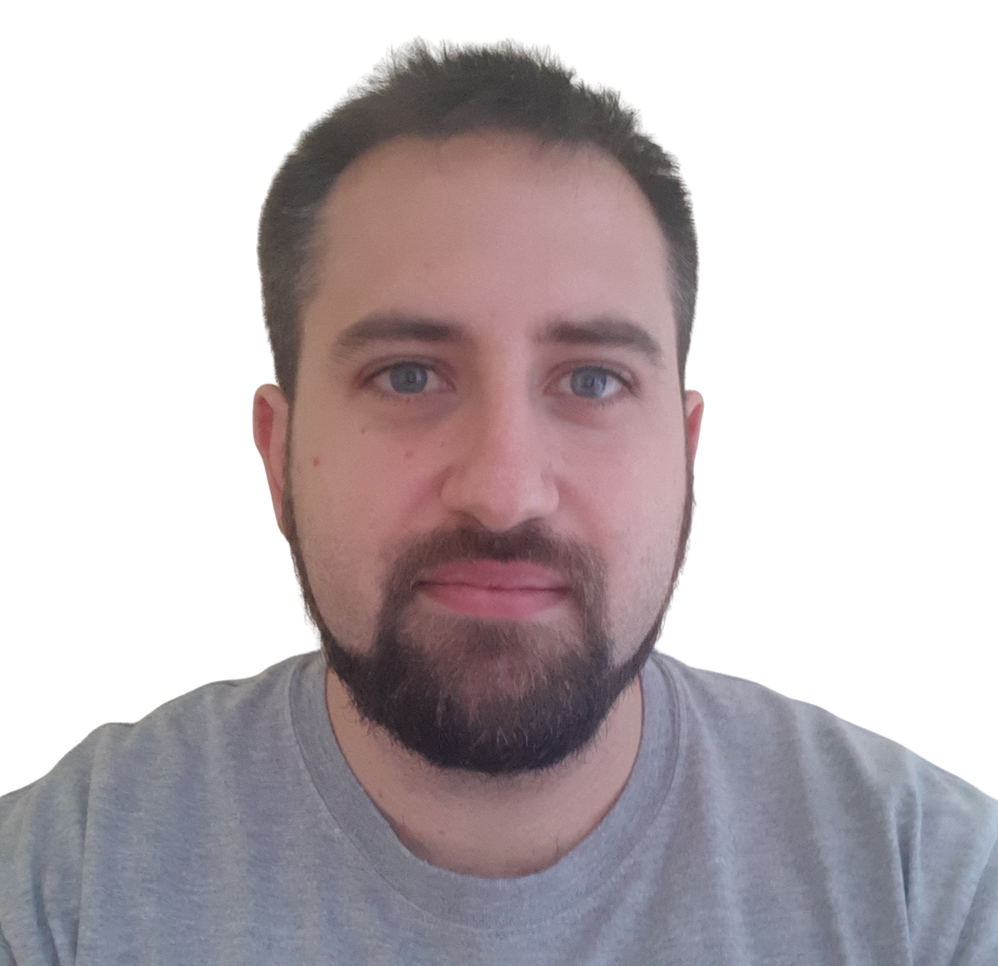
CHARLA
Shift Left, Scale Right - Securizando la infraestructura de AWS a escala con DevSecOps
Viernes 21, Nov
12:50pm - 13:55pm
PABLO SÁNCHEZ CARMONA
TRACK PRINCIPAL - AULA MAGNA
X-OPS CONFERENCE 2025

Slide 24
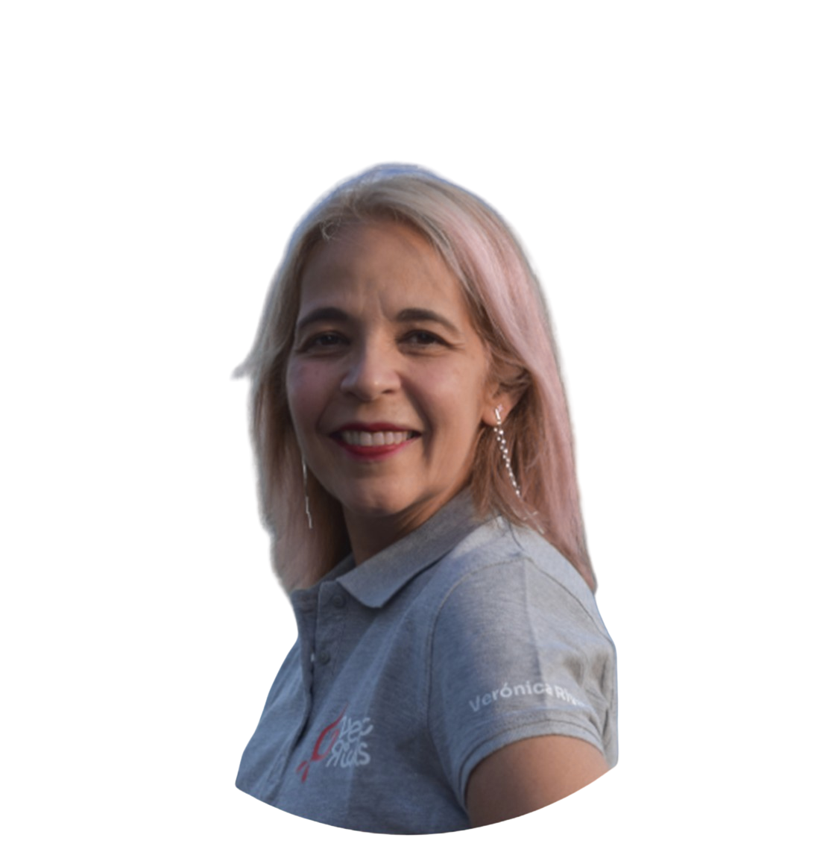
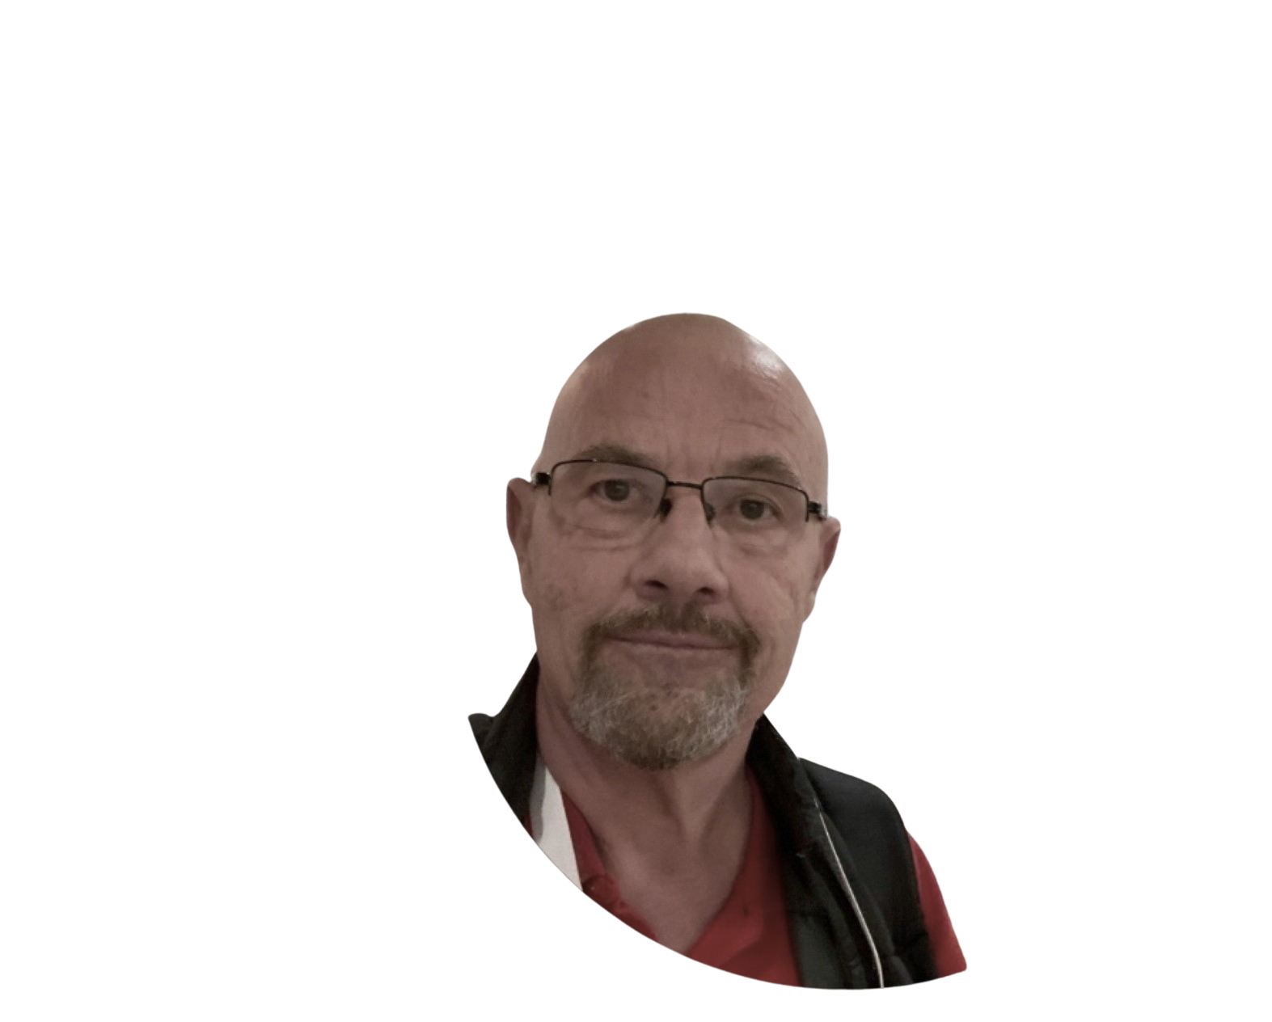
CHARLA
Análisis Predictivo con Copilot: Anticipando Problemas en Entornos AIOps
Sábado 22, Nov
11:50am - 12:20pm
VERÓNICA RIVAS
TONI GRANELL
TRACK PRINCIPAL - AULA MAGNA
X-OPS CONFERENCE 2025

Slide 25

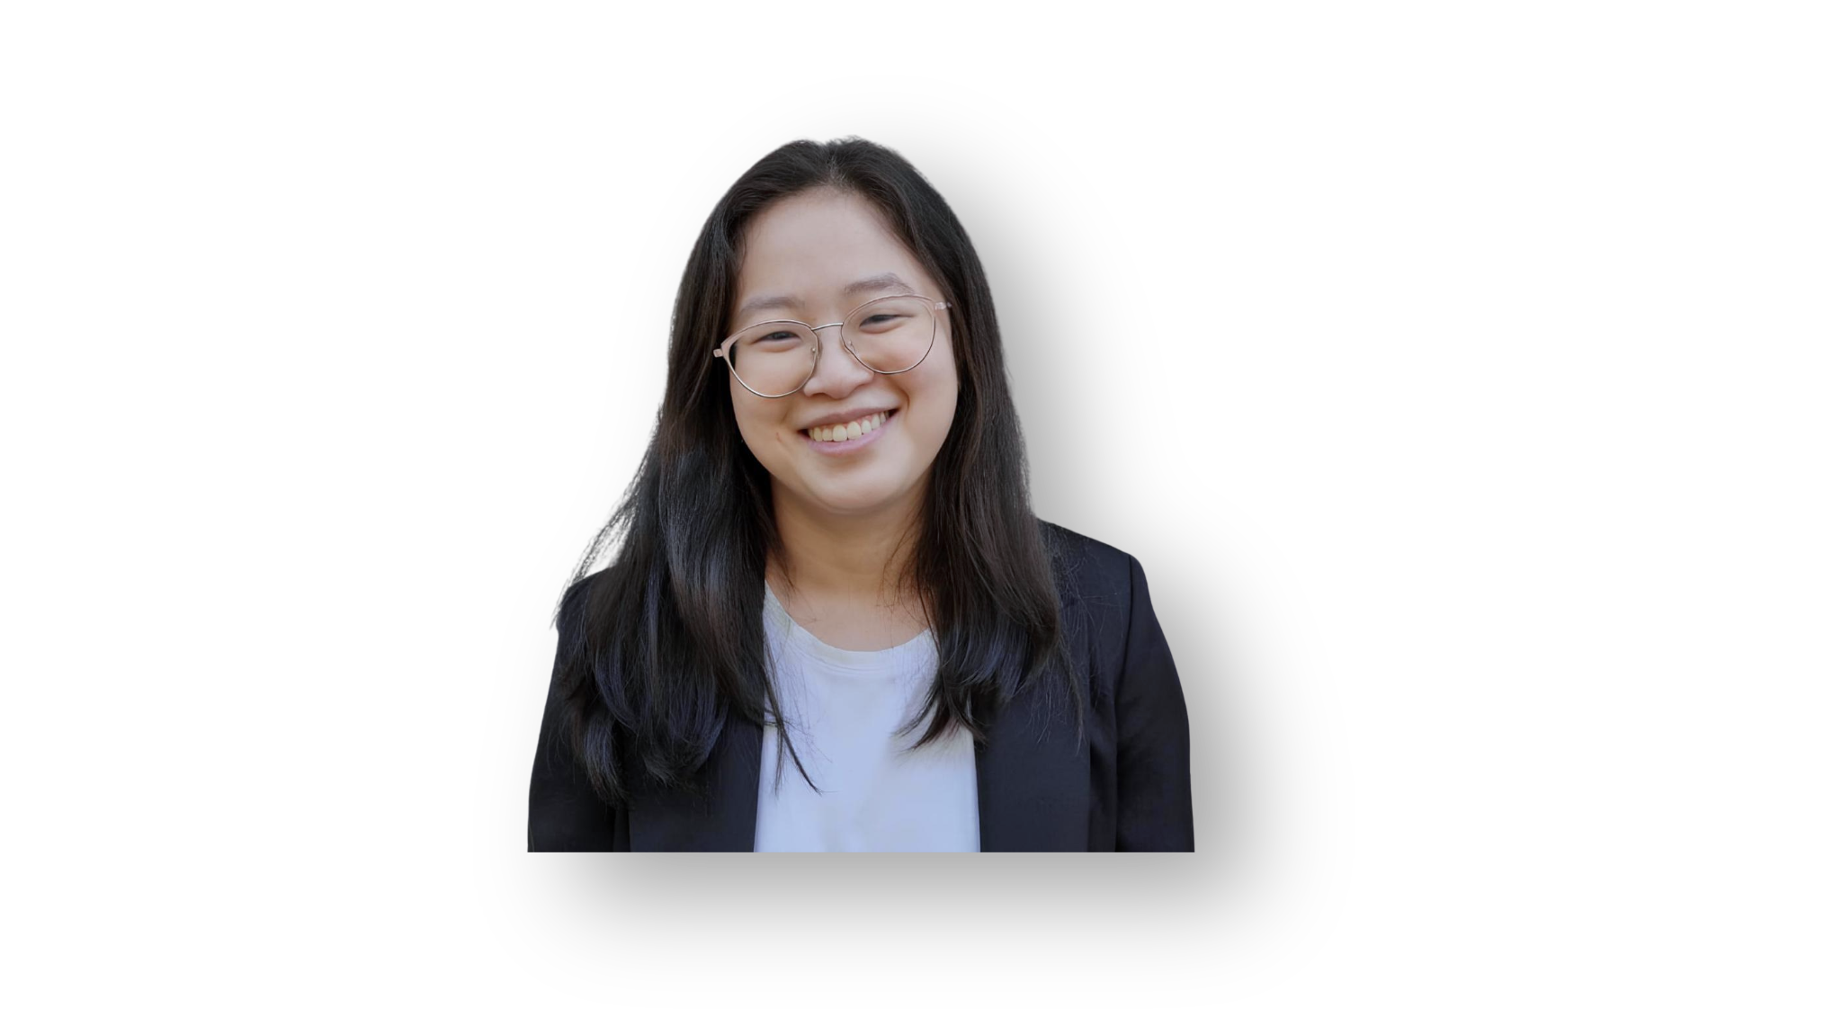
CHARLA
Microsoft Fabric meets AI: Building real-world business solutions
Sábado 22, Nov
11:00am - 11:50am
PATRICIA RODRÍGUEZ
ALMUDENA ZHOU
TRACK PRINCIPAL - AULA MAGNA
X-OPS CONFERENCE 2025

Slide 26
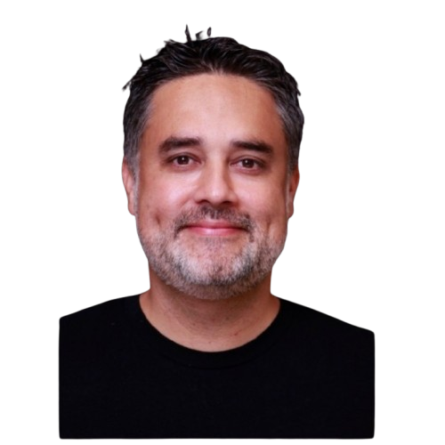
CHARLA
Keynote hyperscalers
Viernes 21, Nov
10:30am - 11:00am
LUIS GUIRIGAY
TRACK HYPERSCALERS - SALA NEXT DIGITAL
X-OPS CONFERENCE 2025

